Slide 1


Random Variable
Dr. Rakhee Chhibber

Slide 2
Agenda
Concept
Discrete and Continuous Random Variable
Probability density function
Mathematical Expectation and their Theorem

Slide 3
Introduction
A random variable in statistics is a function that assigns a real value to an outcome in the sample space of a random experiment. For example: if you roll a die, you can assign a number to each possible outcome.
Random variables can have specific values or any value in a range.

Slide 4
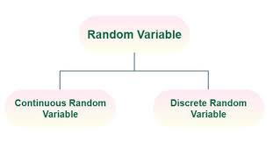
Types of Random Variables
Discrete Random Variables
Continuous Random Variables

Slide 5
Definition of Random Variable
We define a random variable as a function that maps from the sample space of an experiment to the real numbers. Mathematically, Random Variable is expressed as,
X: S →R
where,
X is Random Variable (It is usually denoted using capital letter)
S is Sample Space
R is Set of Real Numbers

Slide 6
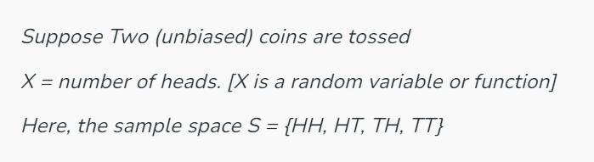
Random Variable Example
Random variables are generally represented by capital letters like X and Y. This is explained by the example below:
If two unbiased coins are tossed then find the random variable associated with that event.

Slide 7
Random Variable Example Contd..
Hence possible values for random variable X are 0, 1, 2.
X = {0, 1, 2} where m = 3
P(X = 0) = (Probability that number of heads is 0) = P(TT) = 1/2×1/2 = 1/4
P(X = 1) = (Probability that number of heads is 1) = P(HT | TH) = 1/2×1/2 + 1/2×1/2 = 1/2
P(X = 2) = (Probability that number of heads is 2) = P(HH) = 1/2×1/2 = 1/4
Here, you can observe that, (0 ≤ p1, p2, p3 ≤ 1/2)
p1 + p2 + p3 = 1/4 + 2/4 + 1/4 = 1

Slide 8
Rolling a Dice
Suppose a dice is thrown (X = outcome of the dice). Here, the sample space S = {1, 2, 3, 4, 5, 6}. The output of the function will be:
P(X=1) = 1/6
P(X=2) = 1/6
P(X=3) = 1/6
P(X=4) = 1/6
P(X=5) = 1/6
P(X=6) = 1/6

Slide 9
Discrete Random Variable
A Discrete Random Variable takes on a finite number of values. The probability function associated with it is said to be PMF.
PMF(Probability Mass Function)
If X is a discrete random variable and the PMF of X is P(xi), then 0 ≤ pi ≤ 1 or Each probability is non-negative.
∑pi = 1 where the sum is taken over all possible values of x or The sum of all probabilities is equal to 1.
Common examples of discrete probability distributions include the binomial distribution, Poisson distribution, and geometric distribution.

Slide 10
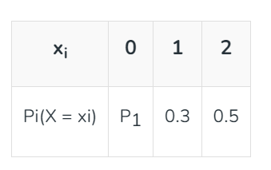
Discrete Random Variables Example
Example: Let S = {0, 1, 2}
Find the value of P (X = 0)

Slide 11
Solution
We know that the sum of all probabilities is equal to 1. And P (X = 0) be P1
P1 + 0.3 + 0.5 = 1
P1 = 0.2
Then, P (X = 0) is 0.2

Slide 12
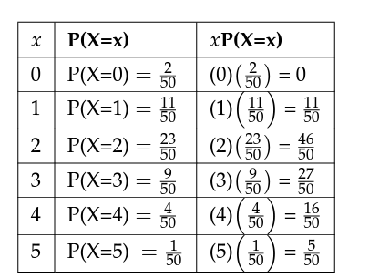
Example - Find the expected value for the example about the number of times a newborn baby’s crying wakes its mother after midnight. The expected value is the expected number of times a newborn wakes its mother after midnight.
Add the last column to find the expected value. µ = Expected Value = 105 Problem 50 = 2.1
You expect a newborn to wake its mother after midnight 2.1 times, on the average.

Slide 13
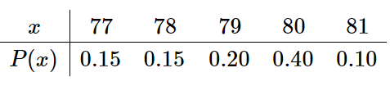
A discrete random variable X has the following probability distribution
Compute each of the following quantities.
P(80) = 0.4
P(X>80) = 0.1
P(X≤80) = P(77) + P(78) + P(79) + P(80) = 0.15 + 0.15 +0.20 + 0.40 =0.9
The mean μ of X. = 79

Slide 14
Example
Suppose you play a game of chance in which you choose 5 numbers from 0, 1, 2, 3, 4, 5, 6, 7, 8, 9. You may choose a number more than once. You pay $2 to play and could profit $100,000 if you match all 5 numbers in order (you get your $2 back plus $100,000). Over the long term, what is your expected profit of playing the game?

Slide 15

Solution
Let X =the amount of money you profit. The values of x are not 0, 1, 2, 3, 4, 5, 6, 7, 8, 9. Since you are interested in your profit (or loss), the values of x are 100,000 dollars and-2 dollars.
To win, you must get all 5 numbers correct, in order. The probability of choosing one correct number is 1/10 because there are 10 numbers. You may choose a number more than once. The probability of choosing all 5 numbers correctly and in order is:
Therefore, the probability of winning is 0.00001 and the probability of losing is 1 −0.00001 = 0.99999

Slide 16
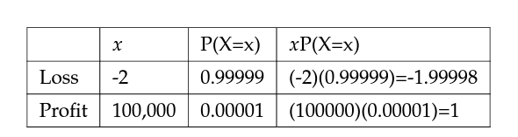
Add the last column.-1.99998 + 1 =-0.99998
Since −0.99998 is about −1, you would, on the average, expect to lose approximately one dollar for each game you play. However, each time you play, you either lose $2 or profit $100,000. The $1 is the average or expected LOSS per game after playing this game over and over.

Slide 17
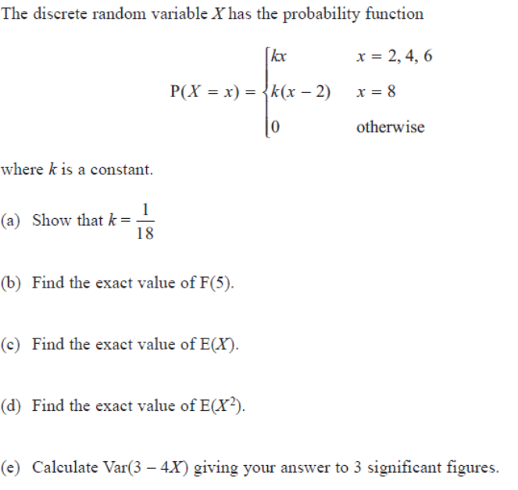

Slide 18
Solution
Show that k = 1/18
P1= When x= 2, 4 6 then kx (k is constant)
So, 2(k) + 4(k) + 6(k) = 12(k)
P2 = When x=8 then k(x-2)
So, k(8-2) = 6k
So p=p1+p2 = 12(k) + 6(k) = 18(k)
K = 1/18

Slide 19
b. Find the exact value of F(5).
For finding F(5)
The value of x should be <=5 and here we have 2 and 4 which is less than 5
F(5) = p(x<=5)
P(x=2) + P(x=4)
2k + 4k
6k
6 * 1/18
1/3

Slide 20

d. Find the exact value of E(X)
E(X) = $∈$ x p(X=x)
= 2(2k) + 4(4k) + 6(6k)
= 104 k
K=1/18
So = 104 * 1/18

Slide 21

e. Find the exact value of E(X²)
E(X) = $∈$ x² p(X=x)
= 2²(2k) + 4²(4k) + 6²(6k)
= 672 k
K=1/18
So = 672 * 1/18
= 112/3

Slide 22
f. Calculate var(3-4x)
Var(X) = E(X²) – E(X)²
⁼ 112/3 – (52/9)²
= 320/81
Var(3-4x) = (-4x) – as 3 is constant so it is 0
= 4² Var(X)
=16 * 320/81
= 63.2

Slide 23
Two Fair Dice
A pair of fair dice is rolled. Let X denote the sum of the number of dots on the top faces.
Construct the
probability distribution
of XX for a paid of fair dice.
Find P(X≥9)P(X≥9).
Find the probability that X takes an even value.

Slide 24
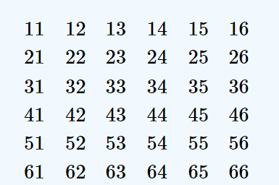
Solution
The sample space of equally likely outcomes is
where the first digit is die 1 and the second number is die 2.

Slide 25
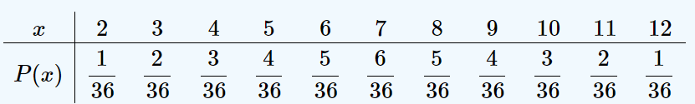
Construct the probability distribution of X for a paid of fair dice.
The possible values for X are the numbers 2 through 12.
X=2 is the event {11}, so P(2)=1/36.
X=3X=3 is the event{12,21}, so P(3)=2/36 and so on.

Slide 26
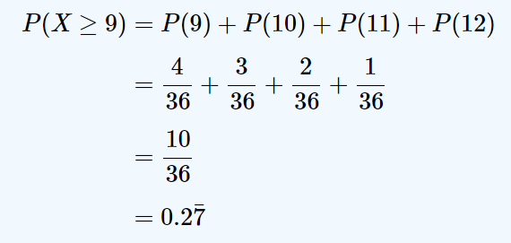
2. Find P(X≥9).
The event X≥9 is the union of the mutually exclusive events X=9, X=10, X=11, and X=12. Thus

Slide 27
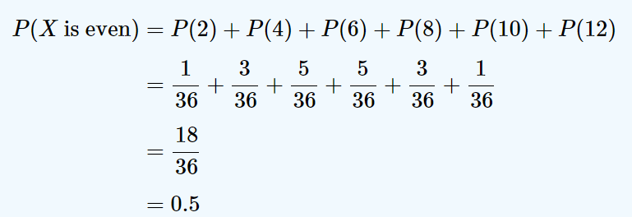
3. Find the probability that X takes an even value.
The probability that X takes an even value must be 0.5, note that X takes six different even values but only five different odd values. We compute

Slide 28
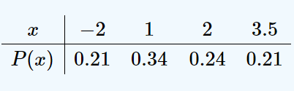
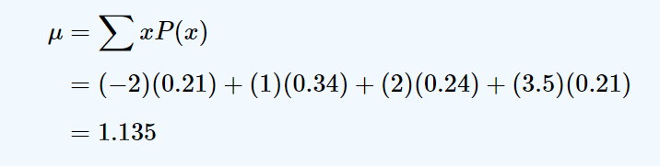
Calculate mean

Slide 29

Practice Question 1
A service organization in a large town organizes a raffle each month. One thousand raffle tickets are sold for $1 each. Each has an equal chance of winning. First prize is $300, second prize is $200, and third prize is $100. Let X denote the net gain from the purchase of one ticket.
Construct the probability distribution of X.
Find the probability of winning any money in the purchase of one ticket.
Find the expected value of X, and interpret its meaning.

Slide 30
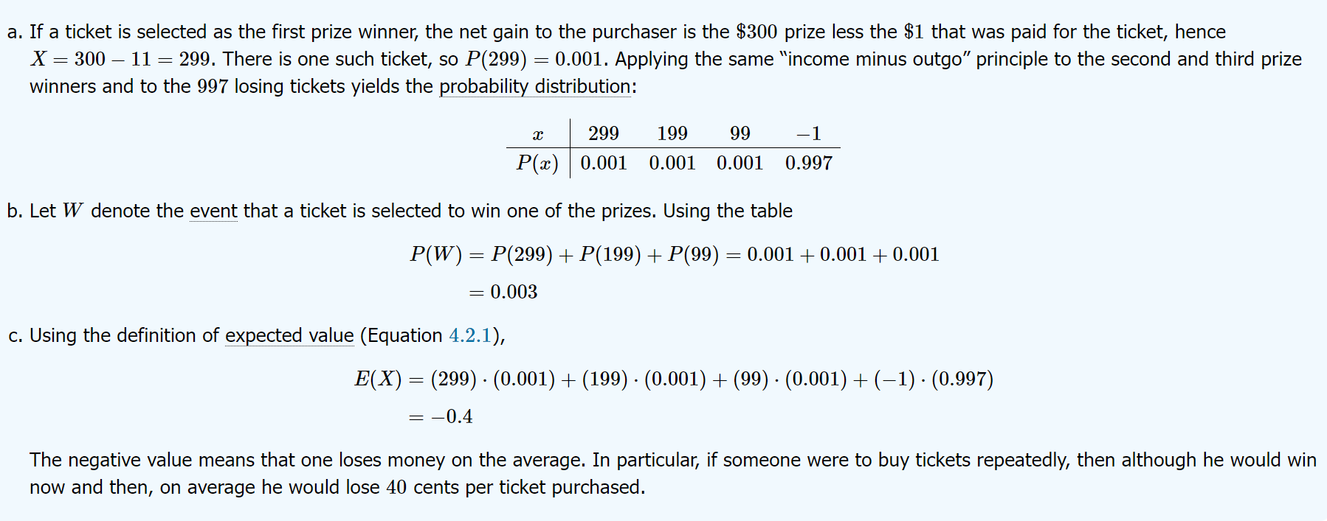

Slide 31

Practice Question 2
A life insurance company will sell a $200,000 one-year term life insurance policy to an individual in a particular risk group for a premium of $195. Find the expected value to the company of a single policy if a person in this risk group has a 99.97% chance of surviving one year.

Slide 32
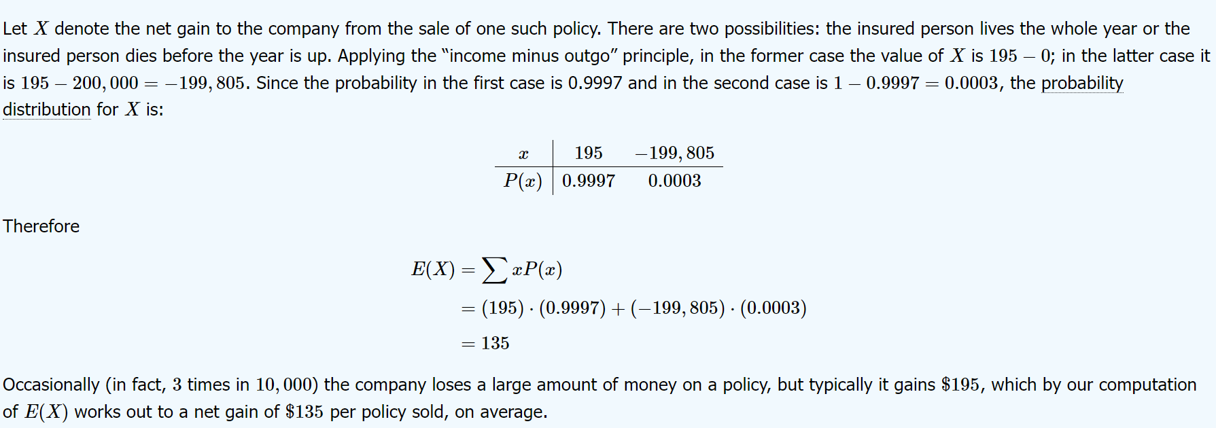

Slide 33
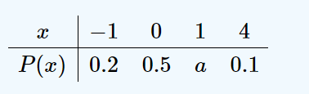
Practice Question 3
A discrete random variable X has the following probability distribution
Compute each of the following quantities.
a
P(0).
P(X>0).
P(X≥0).
P(X≤−2).
The mean μ of X.
The variance σ² of X.
The standard deviation σ of X.

Slide 34
Solution
Since all probabilities must add up to 1,
a=1−(0.2+0.5+0.1)=0.2
2. Directly from the table, P(0)=0.5
P(0)=0.5
From Table
P(X>0)=P(1)+P(4)=0.2+0.1=0.3
From Table
P(X≥0)=P(0)+P(1)+P(4)=0.5+0.2+0.1=0.8

Slide 35
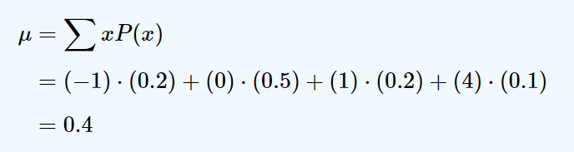
e. Since none of the numbers listed as possible values for X is less than or equal to −2, the event X≤−2 is impossible, so P(X≤−2)=0
f. Using the formula in the definition of μ

Slide 36
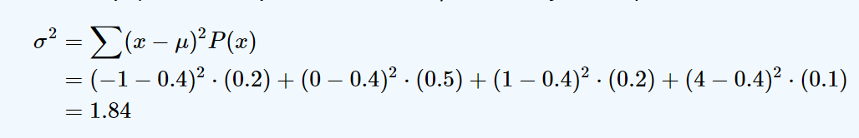
g. Using the formula of σ² and the value of μ that was just computed
h. Using the result of part (g), σ=√1.84=1.3565

Slide 37

Thank You

